Slide 1
Improving Supervised Contrastive Learning For Pre-Trained Language Model Fine-Tuning By Hard Negative Sampling.
Lee hyo jeong 20215539

Slide 2
Problem description
Sentiment analysis (SA): computational study of people’s opinions, attitudes and emotions toward an entity. [1]
Examples from Stanford Sentiment Treebank dataset
The Interview was neither that funny nor that witty. (Negative)
A stirring, funny and finally transporting re-imagining of Beauty and the Beast and 1930s horror films (Positive)
=> Can be considered a classification process
[1] Medhat, Walaa, Ahmed Hassan, and Hoda Korashy. "Sentiment analysis algorithms and applications: A survey." Ain Shams engineering journal 5.4 (2014): 1093-1113.

Slide 3
Drawbacks of cross entropy loss
Lack of robustness to noisy labels
Possibility of poor margins
Leading to reduced generalization performance. [2]
To overcome this..
Contrastive loss and its variations are proposed.
[2] Khosla, Prannay, et al. "Supervised contrastive learning." Advances in Neural Information Processing Systems 33 (2020): 18661-18673.

Slide 4
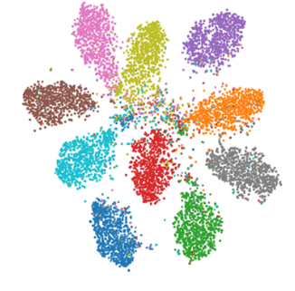
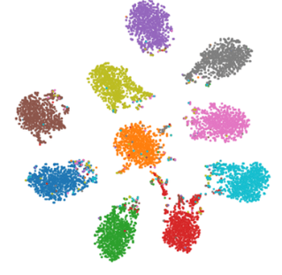
Contrastive learning
Goal of contrastive representation learning :
learn such an embedding space in which similar sample pairs stay close to each other while dissimilar ones are far apart
[Cross-entropy loss] [AMC loss][3]
[3] Choi, Hongjun, Anirudh Som, and Pavan Turaga. "AMC-loss: Angular margin contrastive loss for improved explainability in image classification." Proceedings of the IEEE/CVF conference on computer vision and pattern recognition workshops. 2020.

Slide 5
Supervised Contrastive Learning for Pre-Trained Language Model Fine-Tuning [4]
The first paper that utilized the supervised contrastive loss to NLP task.
Strong improvements in the few-shot learning settings over a very strong baseline – RoBERTa-Large fine-tuned with cross entropy loss
More robust in comparison to RoBERTa-Large fine-tuned with cross entropy
[4] Gunel, Beliz, et al. "Supervised contrastive learning for pre-trained language model fine-tuning." arXiv preprint arXiv:2011.01403 (2020).

Slide 6
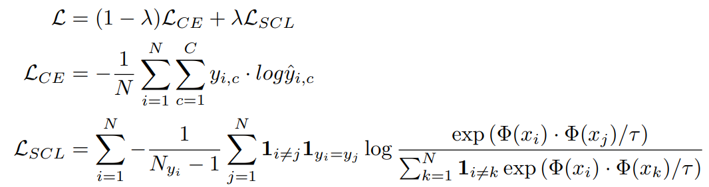
Approach
N : batch size
C : number of classes
Φ(·) : encoder that outputs final encoder hidden layer before softmax
Leading LM model to reduce the distance of the hidden state between positive-positive pair and increase the distance between positive-negative pair
Similarity of positive-positive pair
Sum of Similarity of positive-positive pair and positive-negative pair

Slide 7
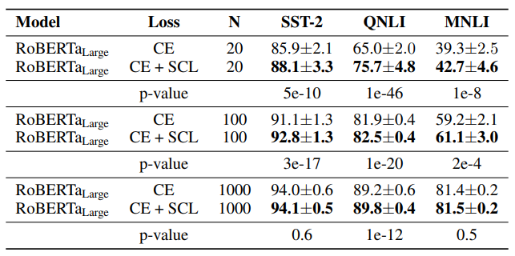
Results (Few-shot)

Slide 8
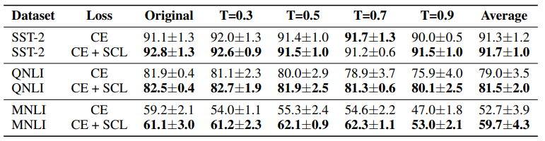
Results (Augmented training sets)

Slide 9
My Contribution
Original paper did not utilize hard-negative sampling which is known to be helpful to use [5]
=> Utilized hard-negative sampling strategy and proposed novel training scheme
[5] Yumin Suh, Bohyung Han, Wonsik Kim, and Kyoung Mu Lee. Stochastic class-based hard example mining for deep metric learning. In IEEE Conference on Computer Vision and Pattern Recognition (CVPR), pp. 7251–7259, 2019.

Slide 10
Hard-negative sampling
Original paper : Randomly select N samples for each batch
Proposed mining scheme
Construct positive training set(batch size: N/2), negative training set(batch size: N/2 * lambda)
Get hidden states from negative batch, positive batch
Get cosine-similarity between positive-negative batch ([N/2, N/2 * lambda])
Select top unique N/2 negative samples that shows high similarity with positive samples

Slide 11
Alternating contrastive learning
Problem of aforementioned hard negative sampling method : There is a possibility that only a subset of hard negative samples contribute to training.
To use the whole training set..
Select one class and consider as anchor class
Hard negative sampling among the other classes
Train the model
Change the anchor class and repeat the process

Slide 12
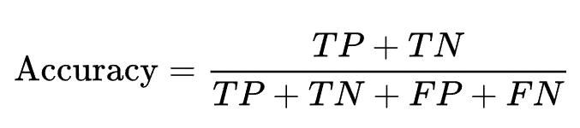
Experiment setting/Evaluation metric
Dataset : sst-2
Model : RoBERTa-large
Epoch : 20
Batch size : 16
Evaluation metric

Slide 13
Experiment results (Few-shot setting)
Training : 100, Test : 1820
 | Cross-Entropy | SCL + CE | SCL-hard + CE | SCL-hard(warm up) + CE
sst2 | 90.08 | 92.38 | 91.01 | 92.59
Training : 50, Test : 1820
 | Cross-Entropy | SCL + CE | SCL-hard + CE | SCL-hard(warm up) + CE
sst2 | 87.55 | 89.45 | 88.71 | 89.66

Slide 14
Further discussion
Needs of experiment on various datasets, noisy datasets
Needs of ablation study to clarify the effect of alternation contrastive learning

